Slide 1
CS 310 Operating Systems Lecture 25 Scheduling – Round Robin, Priority Scheduling, Multilevel Queue Scheduling,
Ravi Mittal
IIT Goa

Slide 2
In this lecture we will study
Last lecture
Scheduling in Interactive Systems
Round Robin Scheduling
Priority Scheduling
Strict Priority Scheduling Multilevel Queue
Adaptive Scheduling - Introduction

Slide 3
Acknowledgements !
Contents of this class presentation has been taken from various sources. Thanks are due to the original content creators:
CS162, Operating System and Systems Programming, University of California, Berkeley
Book: Modern Operating Systems, Andrew Tenenbaum, and Herbert Bos, 4th Edition, Pearson

Slide 4
Reading
Book: Modern Operating Systems, Andrew Tenenbaum, and Herbert Bos, 4th Edition, Pearson
Chapter 2
CS162, Operating System and Systems Programming, University of California, Berkeley

Slide 5
Last Class

Slide 6
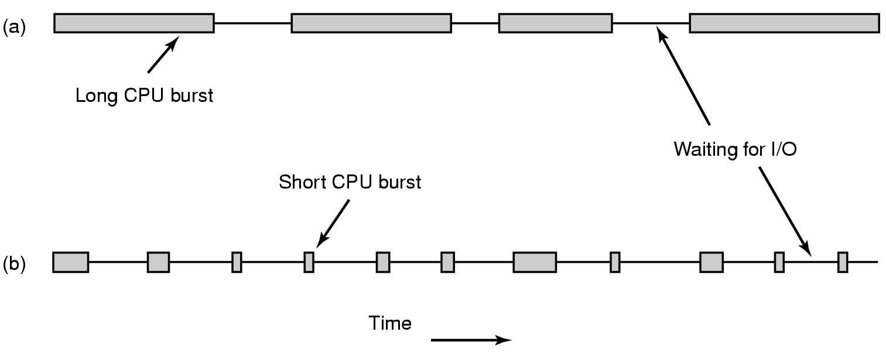
CPU Bursts
CPU-bound process
I/O-bound proces
As processors become faster, processes tend to become more I/O bound
Why?
CPU is becoming faster than the I?O
Adapted from: Tanenbaum, Modern Operating Systems

Slide 7
Non-preemptive vs Preemptive scheduling
Non-preemptive Scheduling Algorithm
Picks up a process to run
Let the process run until it blocks (for I/O or waiting for another process) or voluntarily releases the CPU
A process may run for hours; it will not be forcibly suspended
No scheduling decisions are made during clock interrupts
Preemptive Scheduling
Picks up a process to run
lets the process run for a maximum of some fixed time
At the end of time period, timer interrupt occurs
In Kernel mode, scheduler picks up another ready process to run
Adapted from: Tanenbaum, Modern Operating Systems

Slide 8
Scheduling Algorithms - types
Different environment require different scheduling algorithms
Different applications have different goals → appropriate scheduling algorithms
Categories of Scheduling Algorithms
Batch
Interactive
Real time (deadlines)
Adapted from: Tanenbaum, Modern Operating Systems

Slide 9
Batch System

Slide 10
Scheduling Policy Goals/Criteria
Minimize Response Time
Time between issuing a command and getting result
Maximize Throughput
Maximize operations (or jobs) per second
Minimize Turnaround time
Average elapsed time – primarily for batch system
Fairness
Share CPU among users in some equitable way

Slide 11
First-Come, First-Served (FCFS) Scheduling
First-Come, First-Served (FCFS)
Also First In First Out (FIFO) or Run until done
In early systems, FCFS meant one program scheduled until done (including I/O)
Now, means keep CPU until thread blocks
Simple Algorithm, Easy to implement (+)
FCFS Scheme: Potentially bad for short jobs!
Depends on submit order
If you are first in line at supermarket with milk, you don’t care who is behind you, on the other hand…
Convoy effect: short process stuck behind long process (-)

Slide 12
Shortest Job First (SJF)
Non-preemptive
Run whatever job has least amount of computation to do
Provably optimal
Need to know run times in advance
Kubiatowicz CS162 © UCB Fall 2020

Slide 13
Shortest Remaining Time First (SRTF)
Preemptive version of SJF
If job arrives and has a shorter time to completion than the remaining time on the current job, immediately preempt CPU
Sometimes called Shortest Remaining Time to Completion First (SRTCF)
Both SJF and SRTF:
These can be applied to whole program or current CPU burst
Idea is to get short jobs out of the system
Big effect on short jobs, only small effect on long ones
Result is better average response time
Kubiatowicz CS162 © UCB Fall 2020

Slide 14
Estimating future CPU Burst time
The SRTF algorithm can be applied to whole program or current CPU burst
Sorting based on future burst time?
How do we know it ?
Solution:
Predict future burst based on the past history
Use an estimator function on previous bursts: Let tn-1, tn-2, tn-3, etc. be previous CPU burst lengths. Estimate next burst τn = f(tn-1, tn-2, tn-3, …)
For example: Exponential Averaging
τn = αtn-1+(1-α)τn-1 with (0<α≤1), where
τn : predicted size of the n^{th} CPU burst
tn-1 : the measured time of the (n-1)^{th} burst
α : a weighing factor

Slide 15
Estimating future CPU Burst time
Weighing factor α can be adjusted based on how much to weigh past history versus last observation
If α = 1 then only the last observation of the CPU burst period counts
If α = ½ then the last observation has as much weight as the historical weight

Slide 16
Exponential Average with ⍺ = 0.5, 1, 0.25
Exponential Average (⍺ =0.5)
Exponential Average (⍺ = 1)
Exponential Average (⍺ = 0.25)

Slide 17
Advantages and Disadvantages of SRTF
Advantages
This scheduling is optimal in that it always produces the lowest average response time
Processes with short CPU bursts are given priority and hence run quickly
Disadvantages
Long-burst (CPU-intensive) processes are hurt with a long average waiting time
In fact, if short-burst processes are always available to run, the long-burst ones may never get scheduled
Starvation
The effectiveness of meeting the scheduling criteria relies on our ability to estimate the length of the next CPU burst

Slide 18
Useful metrics
Waiting time for process P: time before P got scheduled
Average waiting time: Average of all processes’ wait time.
Completion time (response time): Waiting time + Run time.
Average completion time (response time): Average of all processes' completion time

Slide 19
Scheduling in Interactive Systems

Slide 20
Scheduling in Interactive Systems
Round Robin
Priority

Slide 21
Round Robin

Slide 22
Round Robin (RR) Scheduling
Uses Preemption!
Each process gets a small unit of CPU time (time quantum), usually 10-100 milliseconds
After quantum expires, the process is preempted and added to the end of the ready queue
n processes in ready queue and time quantum is q
Each process gets 1/n of the CPU time
In chunks of at most q time units
No process waits more than (n-1)q time units
Ref: CS162 © UCB Fall 2020

Slide 23
The magic number
What should q be?
q large ⇒ FCFS
q small ⇒ Interleaved
q must be large with respect to context switch, otherwise overhead is too high (all overhead)
Ref: CS162 © UCB Fall 2020

Slide 24
Example of RR with Time Quantum q = 20
Example: Process Burst Time P₁ 53 P₂ 8 P₃ 68 P₄ 24
The Gantt chart is:
Waiting time for P₁= 0 + (68-20)+(112-88)=72 P₂=(20-0)=20 P₃=(28-0)+(88-48)+(125-108) + 0 =85 P₄=(48-0)+(108-68)=88
Average waiting time = (72+20+85+88)/4=66¼
Average completion time = (125+28+153+112)/4 = 104½
P₁
P₂
P₃
P₄
P₁
P₃
P₄
P₁
P₃
P₃
0
20
28
48
68
88
108
112
125
145
153
Ref: CS162 © UCB Fall 2020

Slide 25
Round-Robin Quantum
Assume that context switch overhead is 0
What happens when we decrease q?
Avg. response time always decreases or stays the same
Avg. response time always increases or stays the same
Avg. response time can increase, decrease, or stays the same
Note: Response time: Time between issuing a command and getting result
Ref: CS162 © UCB Fall 2020

Slide 26
Decrease in Response Time
T₁: Burst Length 10
T₂: Burst Length 1
Q = 10
Average Response Time = (10 + 11)/2 = 10.5
Q = 5
Average Response Time = (6 + 11)/2 = 8.5
T₁
T₂
0
10
11
T₁
T₂
T₁
0
5
6
11
Ref: CS162 © UCB Fall 2020

Slide 27
Same Response Time
T1: Burst Length 1
T2: Burst Length 1
Q = 10
Average Response Time = (1 + 2)/2 = 1.5
Q = 1
Average Response Time = (1 + 2)/2 = 1.5
T₁
T₂
0
1
2
T₁
T₂
0
1
2
Ref: CS162 © UCB Fall 2020

Slide 28
Increase in Response Time
T1: Burst Length 1
T2: Burst Length 1
Q = 1
Average Response Time = (1 + 2)/2 = 1.5
Q = 0.5
Average Response Time = (1.5 + 2)/2 = 1.75
T₁
T₂
0
1
2
0
2
Ref: CS162 © UCB Fall 2020

Slide 29
Round-Robin Scheduling: Discussion
How do you choose time slice?
What if too big?
Response time suffers
What if time slice too small?
Throughput suffers!
Actual choices of timeslice:
Initially, UNIX timeslice one second:
Worked ok when UNIX was used by one or two people
Need to balance short-job performance and long-job throughput:
Typical time slice today is between 10ms – 100ms
Typical context-switching overhead is 0.1ms – 1ms
Roughly 1% overhead due to context-switching
Ref: CS162 © UCB Fall 2020

Slide 30
Comparisons between FCFS and Round Robin
Assuming zero-cost context-switching time, is RR always better than FCFS?
Simple example: 10 jobs, each take 100s of CPU time RR scheduler quantum of 1s All jobs start at the same time
Completion Times:
Both RR and FCFS finish at the same time
Average completion(response) time is much worse under RR!
Bad when all jobs same length
Also: Cache state must be shared between all jobs with RR but can be devoted to each job with FIFO
Total time for RR longer even for zero-cost switch!
Job # | FIFO | RR
1 | 100 | 991
2 | 200 | 992
… | … | …
9 | 900 | 999
10 | 1000 | 1000

Slide 31
Earlier Example with Different Time Quantum
Best FCFS:
P₂
[8]
P₄
[24]
P₁
[53]
P₃
[68]
0
8
32
85
153
Quantum
P₁
P₂
P₃
P₄
Average
Wait
Time
Best FCFS
32
0
85
8
31¼
Q = 1
84
22
85
57
62
Q = 5
82
20
85
58
61¼
Q = 8
80
8
85
56
57¼
Q = 10
82
10
85
68
61¼
Q = 20
72
20
85
88
66¼
Worst FCFS
68
145
0
121
83½
Completion
Time
Best FCFS
85
8
153
32
69½
Q = 1
137
30
153
81
100½
Q = 5
135
28
153
82
99½
Q = 8
133
16
153
80
95½
Q = 10
135
18
153
92
99½
Q = 20
125
28
153
112
104½
Worst FCFS
121
153
68
145
121¾
Ref: CS162 © UCB Fall 2020

Slide 32
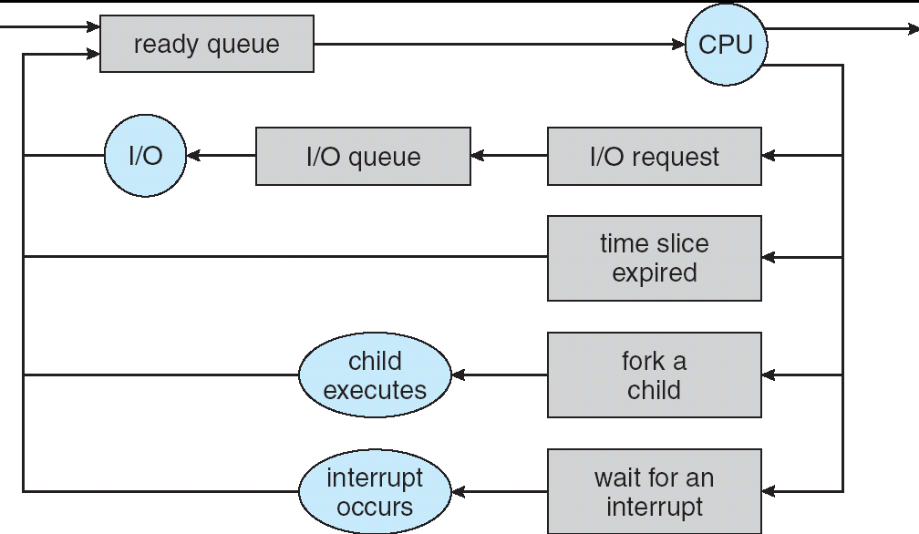
How to Implement RR in the Kernel?
FIFO Queue, as in FCFS
But preempt job after quantum expires, and send it to the back of the queue
How? Timer interrupt!
Ref: CS162 © UCB Fall 2020

Slide 33
Priority Scheduling

Slide 34
Priority Scheduling
Run jobs according to their priority
In RR or other Scheduling there is one queue of jobs
Scheduler selects the highest priority process
It takes O(n) time
Solution
Separate queue for each distinct priority
Schedule the process in the highest priority queue
Ref: CS162 © UCB Fall 2020

Slide 35
Multilevel Queue Scheduling – Strict Priority
Priority 3
Job 1
Job 2
Job 3
Priority 2
Job 4
Priority 1
Priority 0
Job 5
Job 6
Job 7
Execution Plan
Always execute highest-priority runnable jobs to completion
Each queue can be processed in RR with some time-quantum
A priority is assigned statically to each process, and a process remains in the same queue for the duration of the run time
Problems
Starvation
Lower priority jobs don’t get to run because higher priority jobs
Deadlock: Priority Inversion
Happens when low priority task holds a lock needed by high-priority task
Ref: CS162 © UCB Fall 2020

Slide 36
Multi level queue: Strict Priority Scheduling: Fairness Issues
Strict fixed-priority scheduling between queues is unfair (run highest, then next, etc):
Long running low priority jobs may never get CPU
When you shut down machine, you may find 10-year-old job still waiting to run ??
Must give long-running jobs (with low priority) a fraction of the CPU even when there are higher priority jobs to run
Ref: CS162 © UCB Fall 2020

Slide 37
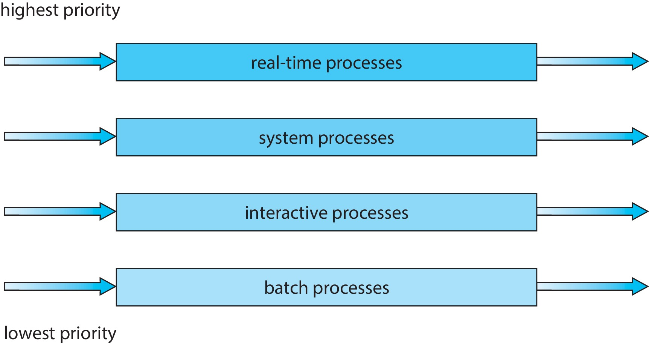
Multilevel Queue Scheduling (for different process types)
Prioritization based upon process type

Slide 38
Adaptive Scheduling

Slide 39
Adaptive Scheduling
How can we adapt the scheduling algorithm based on threads’ past behavior?
Two steps:
Based on past observations, predict what threads will do in the future
Make scheduling decisions based on those predictions
Now, let’s look at the first step. How can we predict future behavior from past behavior?
Ref: CS162 © UCB Fall 2020

Slide 40
Predicting Future Behavior
Consider Round-Robin Scheduling
If process exhausts quantum, has to be preempted
Consuming all of the CPU time it can: “CPU-Bound”
Likely to remain CPU-Bound
If process blocks on I/O before quantum exhausted
Short CPU bursts, just to initiate I/O: “I/O-Bound”
Often interactive tasks
Likely to remain I/O-Bound and/or Interactive
Ref: CS162 © UCB Fall 2020

Slide 41
How to implement Fairness?
Could give each queue some fraction of the CPU?
Could increase priority of jobs that don’t get service
What rate should you increase priorities?
And, as system gets overloaded, no job gets CPU time, so everyone increases in priority
Interactive jobs suffer
Multilevel Feedback Queue
Ref: CS162 © UCB Fall 2020

Slide 42
Lecture Summary
Interactive systems use scheduling that reduce average response time
Round Robin is the oldest, simplest, fairest, and widely used scheduling algorithm
In round robin algorithm, proper choice of time quantum is very important
If the time quantum is too short, there will too many context switches → lower CPU utilization
If the time quantum is too big, there will be high values of wait time and response time → poor response to short interactive requests
Priority scheduling
Multilevel Queue Scheduling – Strict Priority
Adaptive Scheduling

Slide 43
Backup

Slide 44
Types of Resource
Preemptible
OS can take resource away, use it for something else, and give it back later
E.g., CPU
Non-preemptible
Once given resource, it can’t be reused until voluntarily relinquished
E.g., disk space
Given set of resources and set of requests for the resources, types of resource determines how OS manages it

Slide 45
Scheduling Assumptions
Many implicit assumptions for CPU scheduling:
One program per user
One thread per program
Programs are independent
Clearly, these are unrealistic but they simplify the problem so it can be solved
For instance: is “fair” about fairness among users or programs?
If I run one compilation job and you run five, you get five times as much CPU on many operating systems
The high-level goal: Dole out CPU time to optimize some desired parameters of system
USER1
USER2
USER3
USER1
USER2
Time

Slide 46
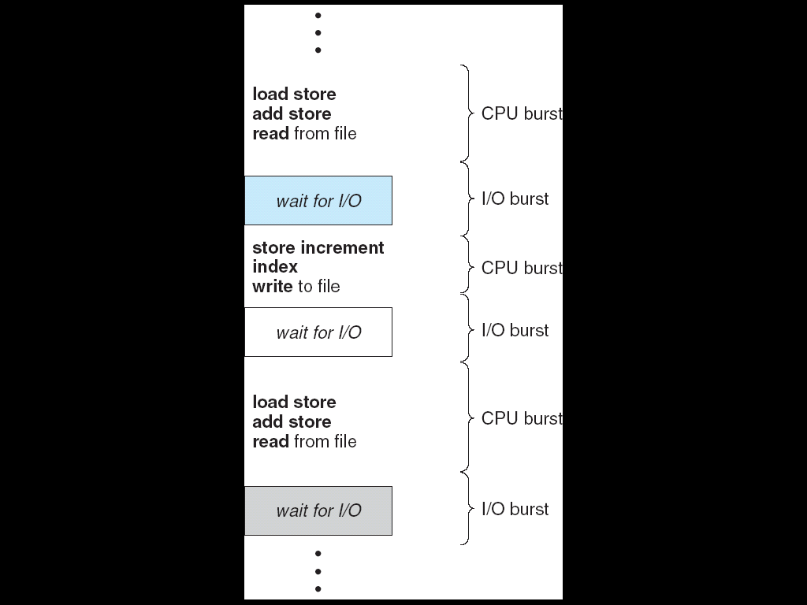
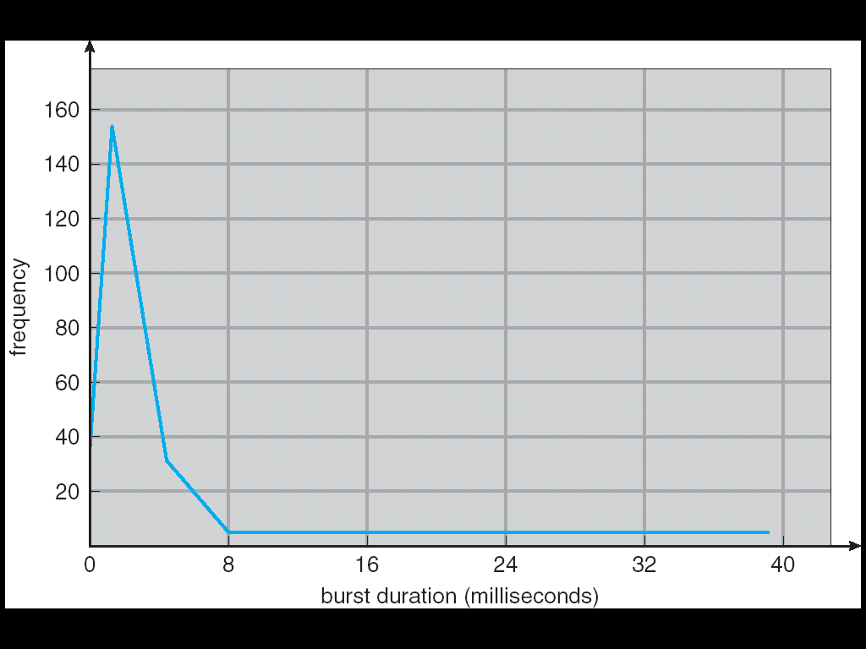
Assumption: CPU Bursts
Weighted toward small bursts
Execution model: programs alternate between bursts of CPU and I/O
Program typically uses the CPU for some period of time, then does I/O, then uses CPU again
Each scheduling decision is about which job to give to the CPU for use in next CPU burst
If a process comes back after I/O wait, it counts as a fresh CPU burst
With time-slicing, thread may be forced to give up CPU before finishing current CPU burst

